Slide 1
Future of Work and Workers
Special Session, CDC 2023
December 14, 2023

Slide 2
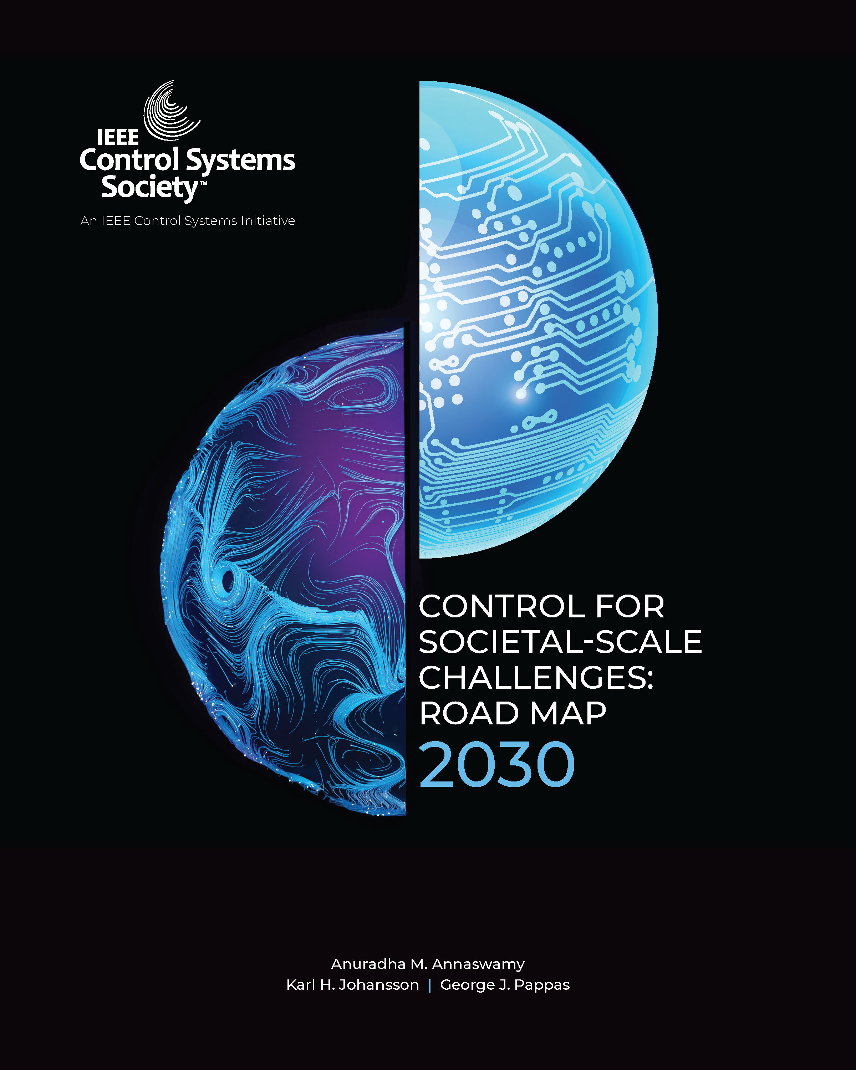
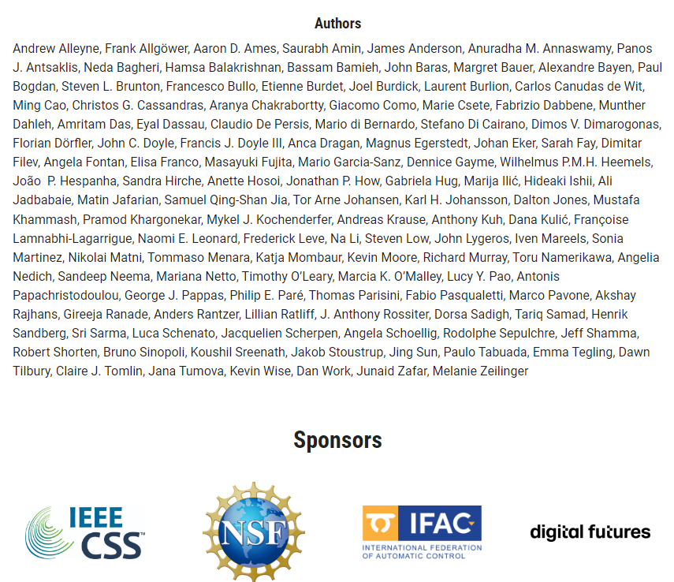
Context
The world faces some of its greatest challenges of modern time and how we address them will have a dramatic impact on the life for generations to come. Advances and transformations in Control Systems urge a shift in the conversation toward how control systems research can meet grand societal- scale challenges. The document seeks to chart a roadmap for the evolution of control systems, identifying several areas where our discipline can have an impact over the next decade.

Slide 3
Special Sessions at this CDC
Societal Drivers
Climate Change & Empower a Billion Lives
Wednesday, Dec 13
Chat GPT & Control
Technological Trends
Human & Technology Partnership
Thursday, Dec 14
Future of Work & Automation
Today
The world faces some of its greatest challenges of modern time and how we address them will have a dramatic impact on the life for generations to come. Advances and transformations in Control Systems urge a shift in the conversation toward how control systems research can meet grand societal- scale challenges. The document seeks to chart a roadmap for the evolution of control systems, identifying several areas where our discipline can have an impact over the next decade.

Slide 4
Special Sessions at this CDC
Future of Work and Workers: Potential Roles for Automation and Control
Pramod Khargonekar
UC Irvine, USA

