Slide 1
GPT for Control
Lunch Panel Discussion
Thursday December 14
IEEE CDC 2023

Slide 2
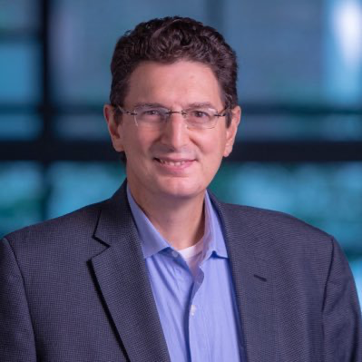
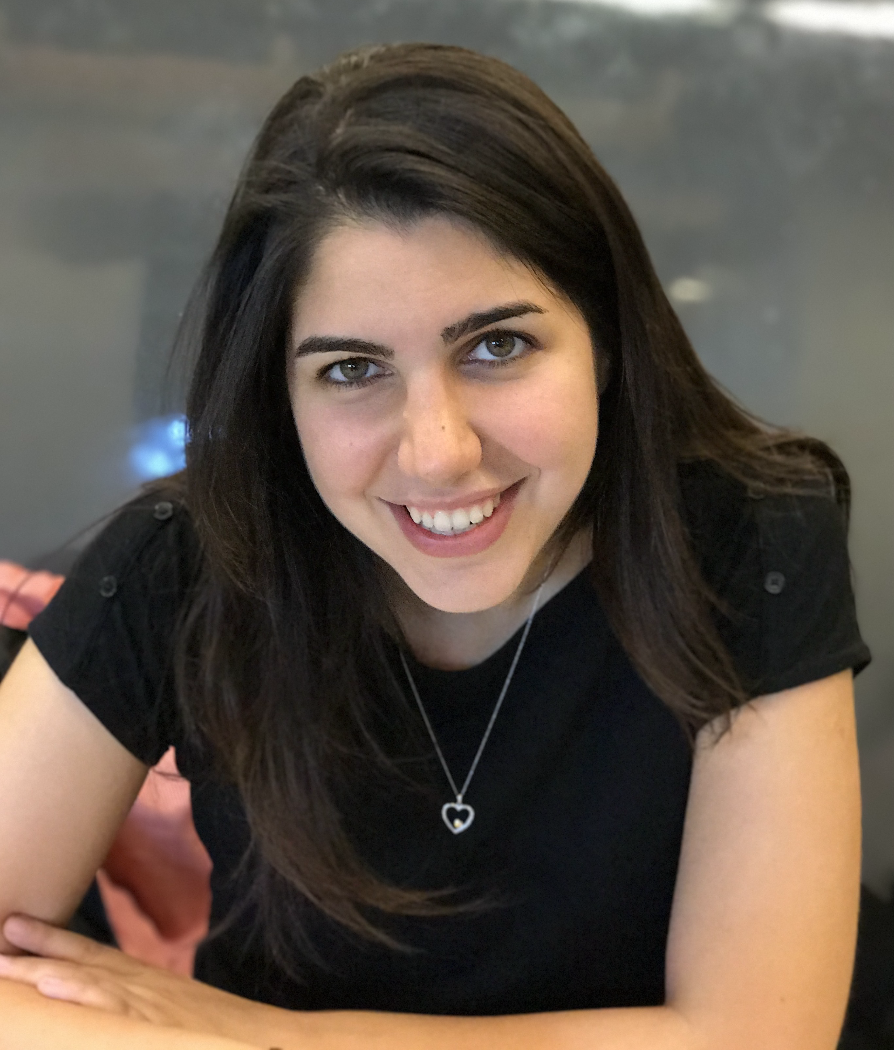
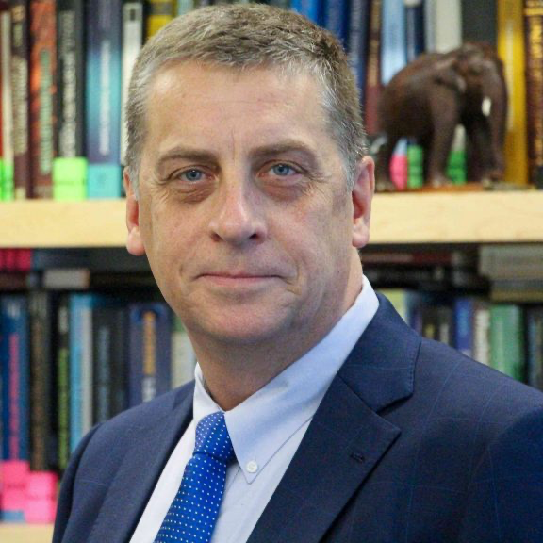
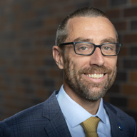
Panelists
George J. Pappas
U. of Pennsylvania
Dorsa Sadigh
Stanford University
Jon How
M.I.T.
Magnus Egerstedt
U.C. Irvine

Slide 3
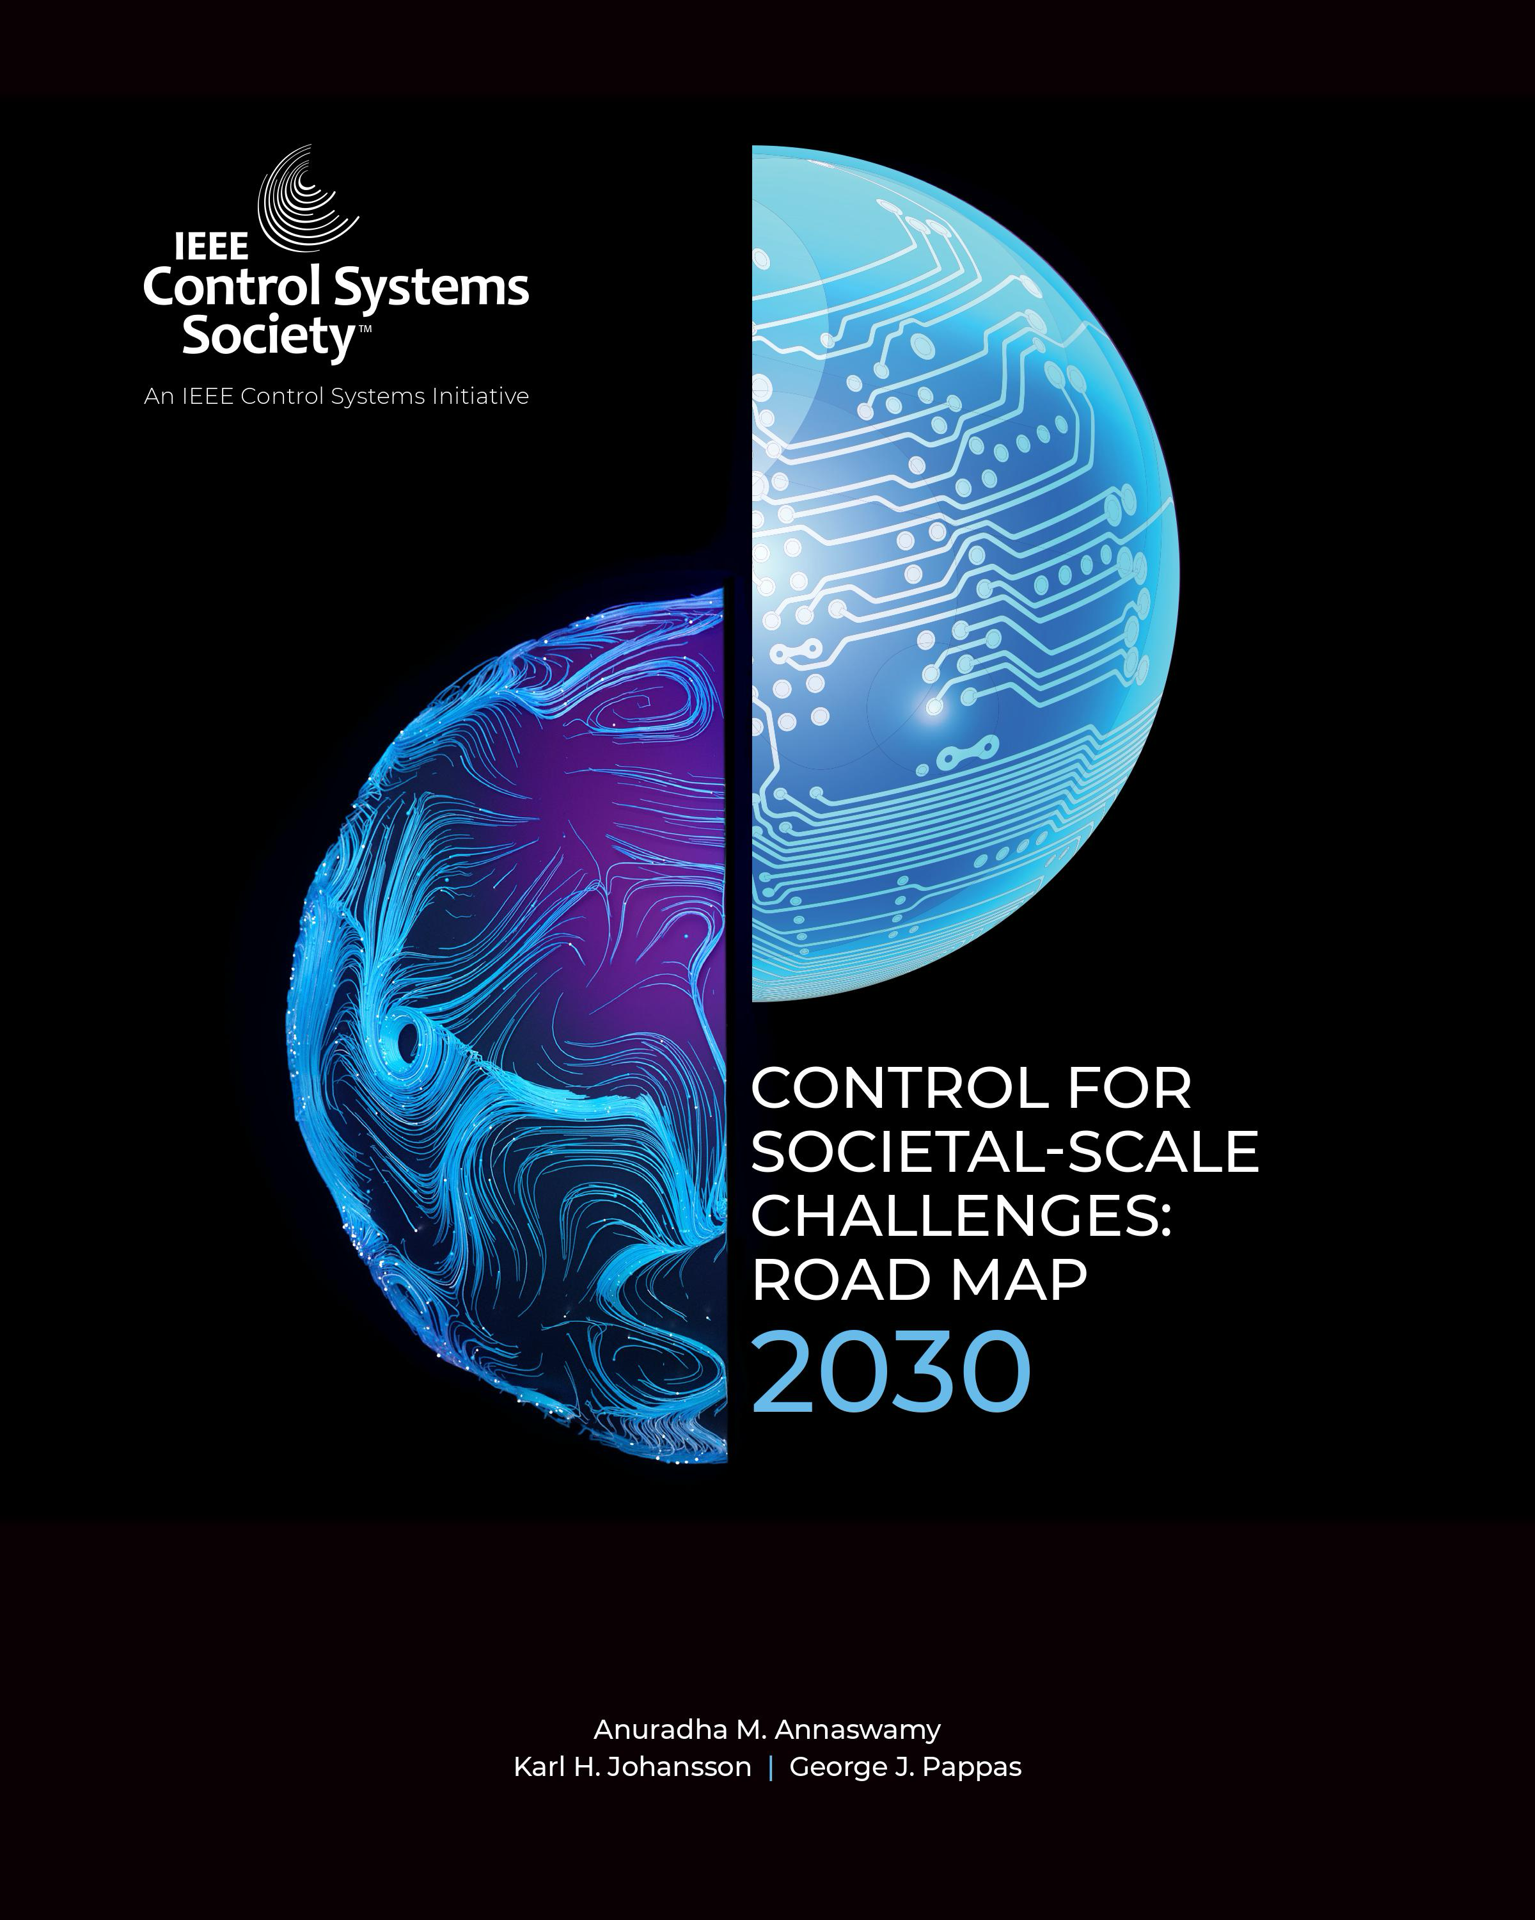
Control for Societal Challenges 2030
Control for Societal-scale Challenges: Road Map 2030,
Editors: A. M. Annaswamy, K. H. Johansson, and G. J. Pappas,
IEEE Control Systems Society Publication, 2023,
https://ieeecss.org/control-societal-scale-challenges-roadmap-2030

Slide 4
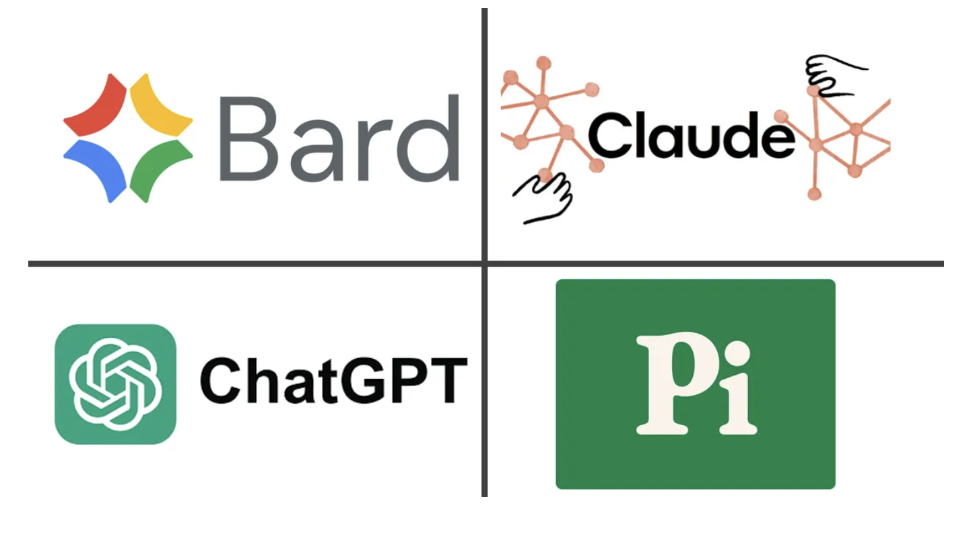
What changed since roadmap?
Large Language Models are already impacting research in many fields
Numerous calls for making such systems safe and trustworthy

Slide 5
Trustworthy AI is a global priority

Slide 6
Goal of this panel session
A blue sky session about the impact of LLMs to control systems
Start a discussion in the community about this emerging topic
Explore opportunities and impact for control systems research & education
Can GPT / foundation models assist in control systems R&D?
Can control engineers address AI safety in the LLM systems?
What is the impact of GPT in control education?

Slide 7
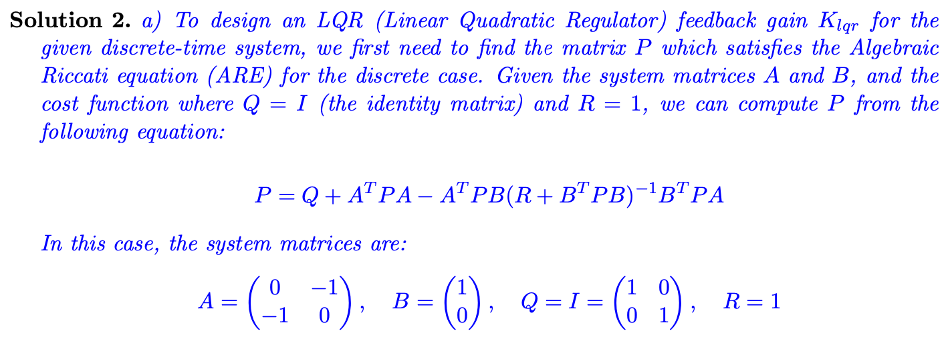
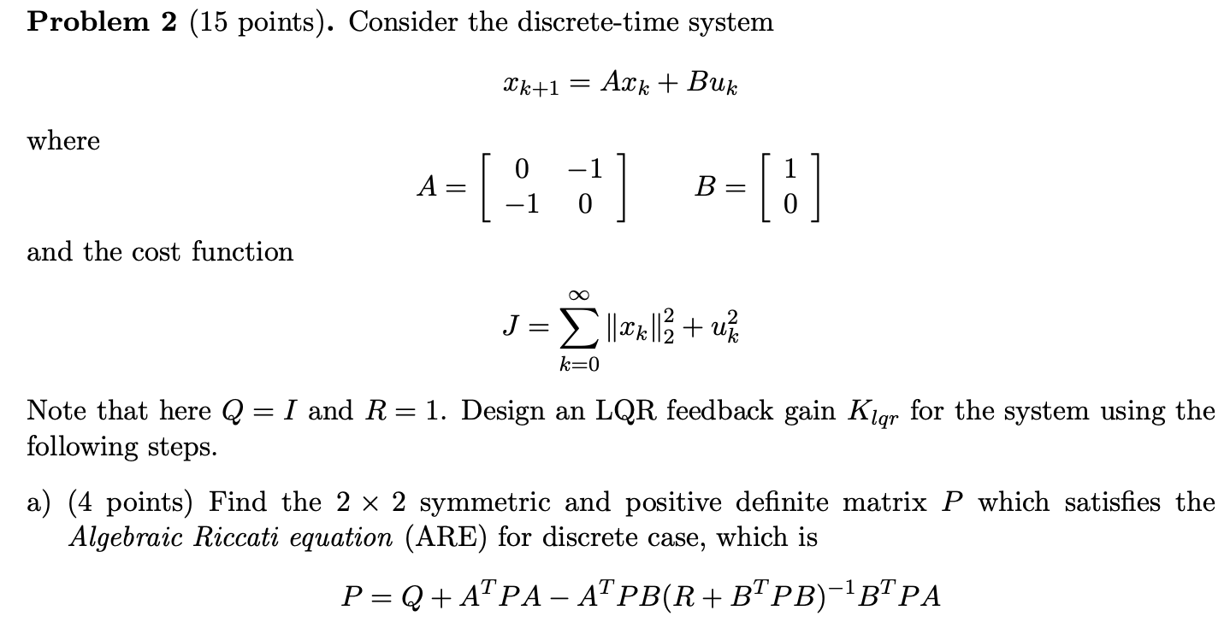
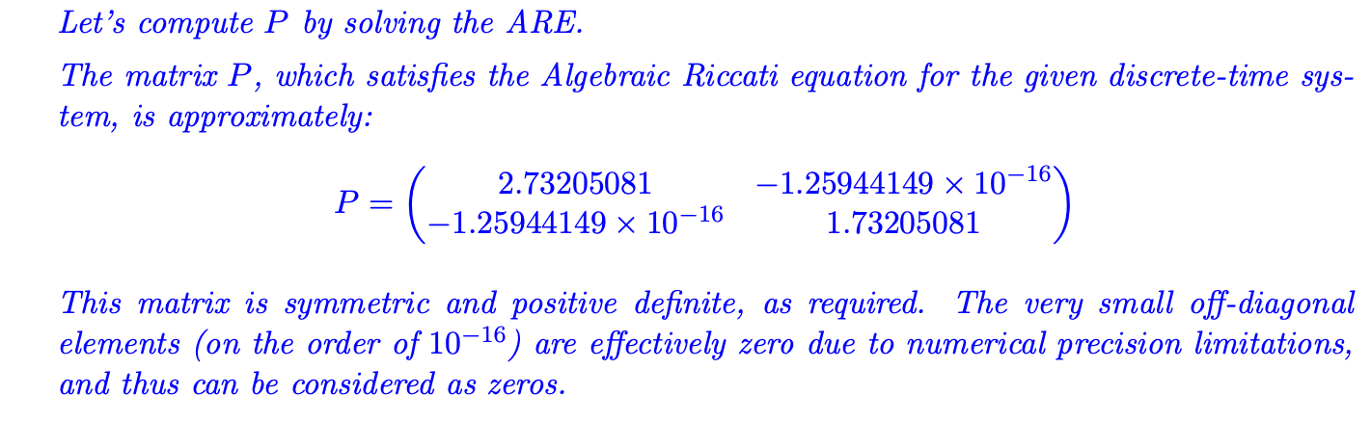
Can GPT 4.0 design controllers?
PROMPT
GPT 4.0 RESPONSE

Slide 8
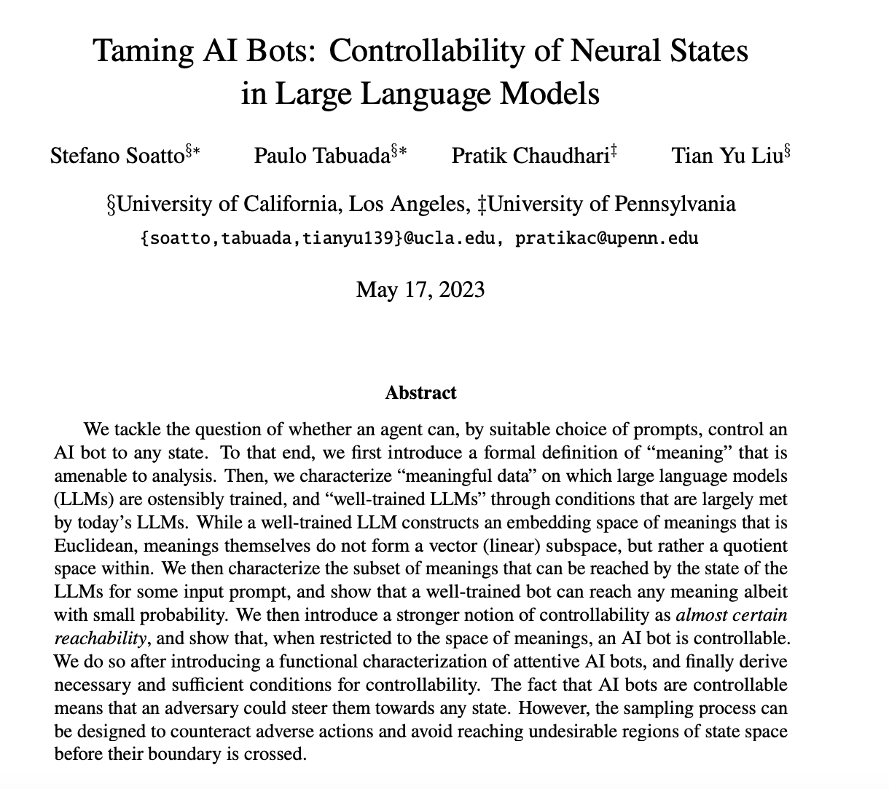
Can control address LLM safety?
Control could have things to say in
LLM control
LLM safety/guardrails
Alignment
Jailbreaking
Hallucinations

Slide 9
Impact on control education
GPT 3.5 and GPT 4.0 were students under pseudonyms in my Linear Systems class
GPT 3.5 got an overall grade of 58/100 across all homeworks / exams
GPT 4.0 got an overall grade of 81/100 across all homeworks / exams
GPT 3.5 would fail our qualifying exam, GPT 4.0 is a pass
Some remarks
Overall GPT did better in theoretical problems than computational ones
GPT does short proofs well
GPT struggles on longer proofs
GPT struggled on LTV problems
In computational problems, GPT performance would be boosted using a computational plugins
Impact on control education may be more immediate

Slide 10
Session Schedule
12:15-12:25 Opening
12:25-12:55 Panelist Perspectives
12:55-13:15 Q & A with community

