Slide 1
Climate Change, Empower a Billion Lives, and CSS
Anu Annaswamy
Past President, CSS

Slide 2
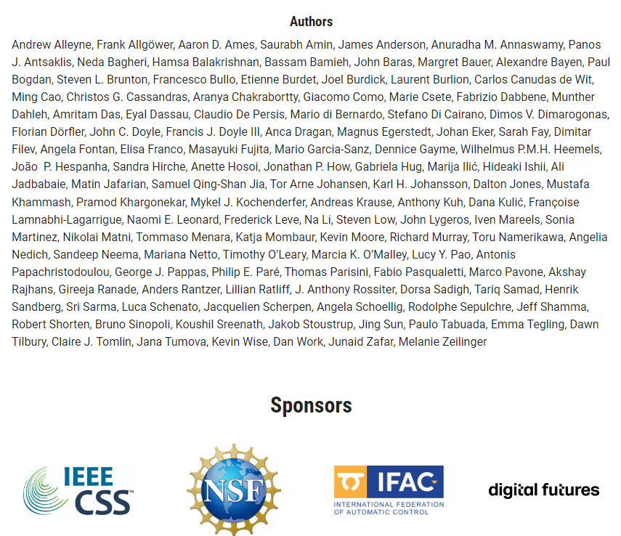
Context
The world faces some of its greatest challenges of modern time and how we address them will have a dramatic impact on the life for generations to come. Advances and transformations in Control Systems urge a shift in the conversation toward how control systems research can meet grand societal- scale challenges. The document seeks to chart a roadmap for the evolution of control systems, identifying several areas where our discipline can have an impact over the next decade.

Slide 3
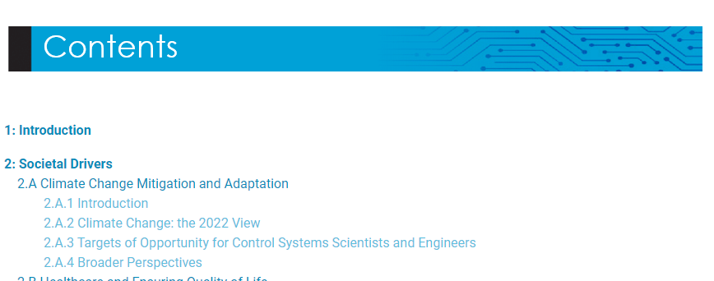
Climate Change: A key societal driver
The world faces some of its greatest challenges of modern time and how we address them will have a dramatic impact on the life for generations to come. Advances and transformations in Control Systems urge a shift in the conversation toward how control systems research can meet grand societal- scale challenges. The document seeks to chart a roadmap for the evolution of control systems, identifying several areas where our discipline can have an impact over the next decade.

Slide 4
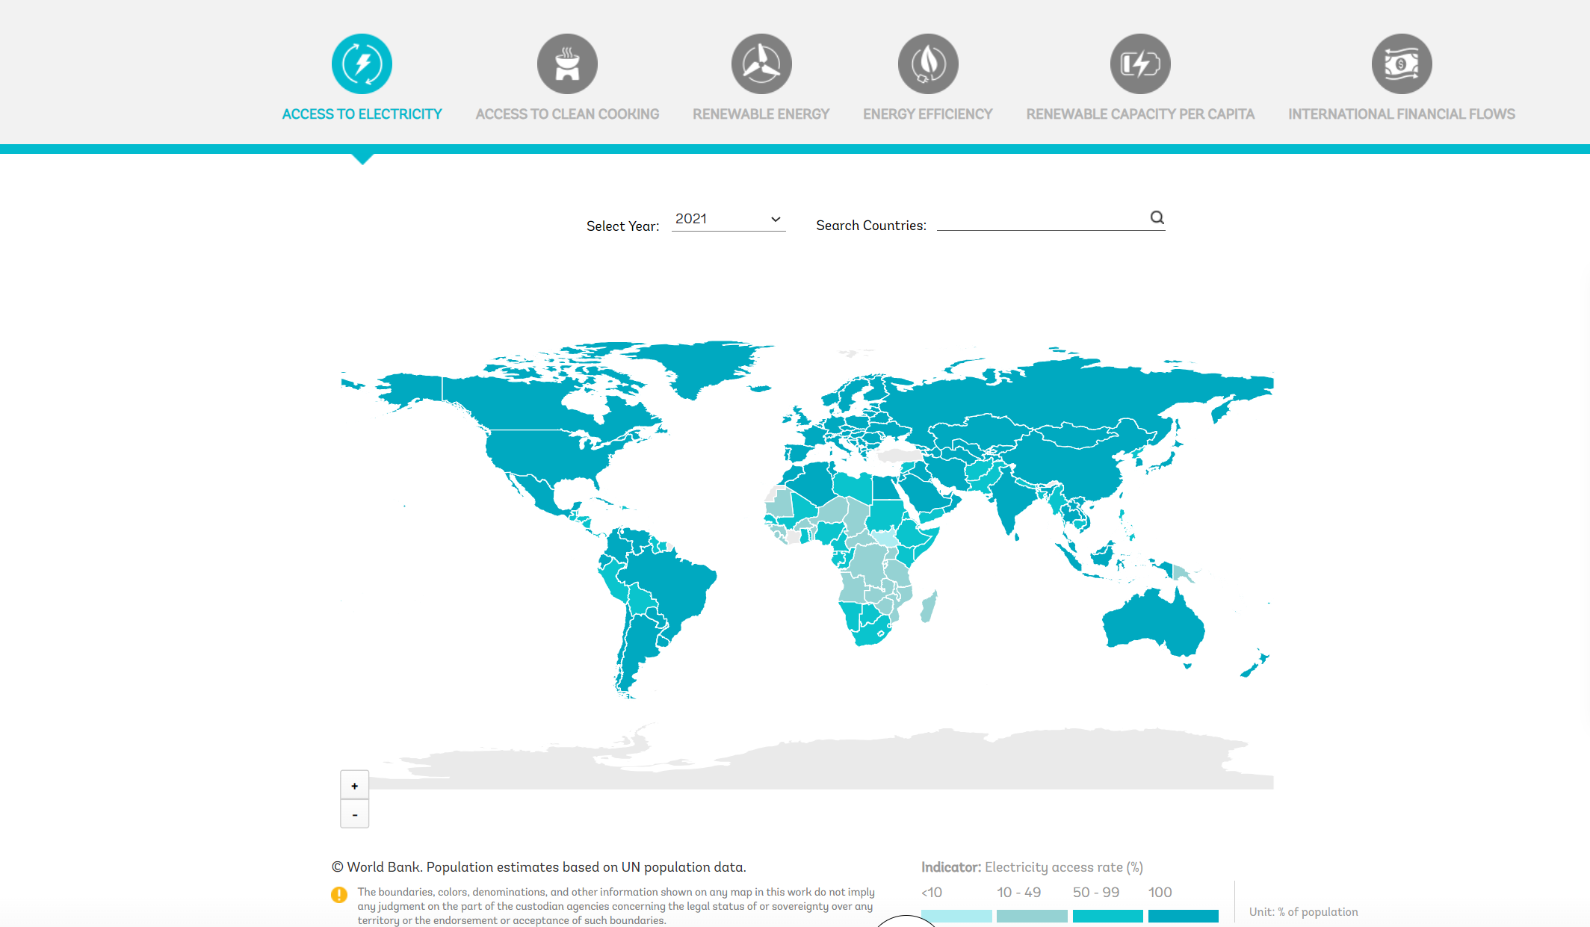
Empower A Billion Lives
Source: https://trackingsdg7.esmap.org/
About a billion do not have access to electricity

Slide 5
Empower A Billion Lives
About 2.3 billion people use polluting fuels and technologies
Source: https://trackingsdg7.esmap.org/

Slide 6
Empower A Billion Lives
About 22 countries make up 80% of the electrification challenge
About 21 countries make up 80% of the clean cooking challenge
Energy planners do not always employ all of their tools in their toolbox to develop energy access stragies

Slide 7
Empower A Billion Lives Competition
Goal: Address the SDG 7 goals of affordable and clean energy access
EMPOWER A BILLION LIVES: A biennial competition on technologies for energy access
Main sponsor: IEEE Power Electronics Society
IEEE Control Systems Society is a diamond sponsor (support of $100,000)

Slide 8
Empower A Billion Lives Competition
Low cost energy solutions through technology
Solutions should provide at least the equivalent of Tier 2 access
Access quantified by World Bank* in terms of capacity and duration
Tier 2: Minimum 50W, 200 Wh, 4 hrs/day, 2 hrs/evening
Lighting, air-circulation, phone charging, television
Solutions should be scalable, affordable, and demonstrate business viability
Two online rounds, then a regional field-testing round, and a global final round
* Energy Access Redefined, ESMAP Report, 2015

Slide 9
EBL-I
Held in 2018
EBL-I attracted 450 teams from 70 countries
Five regional competitions – China, India, Africa, Europe, US
Field demonstrations in Nepal, Rwanda, Malaysia, Madagascar, Uganda, Cambodia, Singapore, India, China, Tanzania, Kenya, Ivory Coast
Solutions presented: microgrids, nanogrids, solar home systems, improved business models
Grand prize of $100,000: SouLS**, IIT Bombay
** Solar Urja through Localization for Sustainability, https://www.soulsiitb.in/

Slide 11
EBL-II: The highlights
200 teams from around the planet registered.
November 2021 – April 2022: Concept paper evaluation
30% of the teams invited to submit a full proposal
May 2022: August 2022 - 8 full proposals were reviewed by the Task Force
Sep 2022 – Jan 2023: Teams were required to validate their concepts using a field test.
March 2023: 25 teams were invited to present their concepts
Grand prize of $150,000: Team Nanoe from Madagascar
Automation track prize of $50,000: Team Green Empowerment from South-east Asia

